Slide 1



Anti-theft App
Demo recording hyperlink
Developed by:
Abhiraj
Niko
Ramprakash

Slide 2
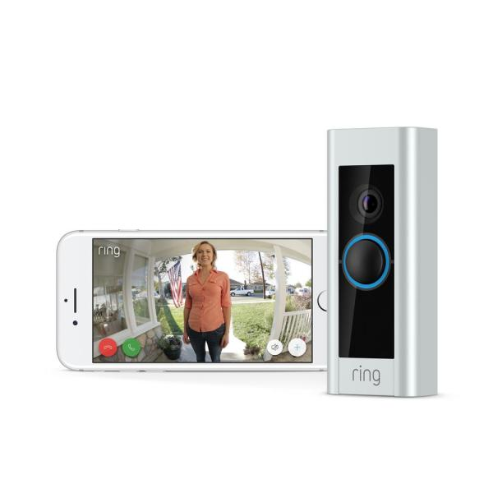
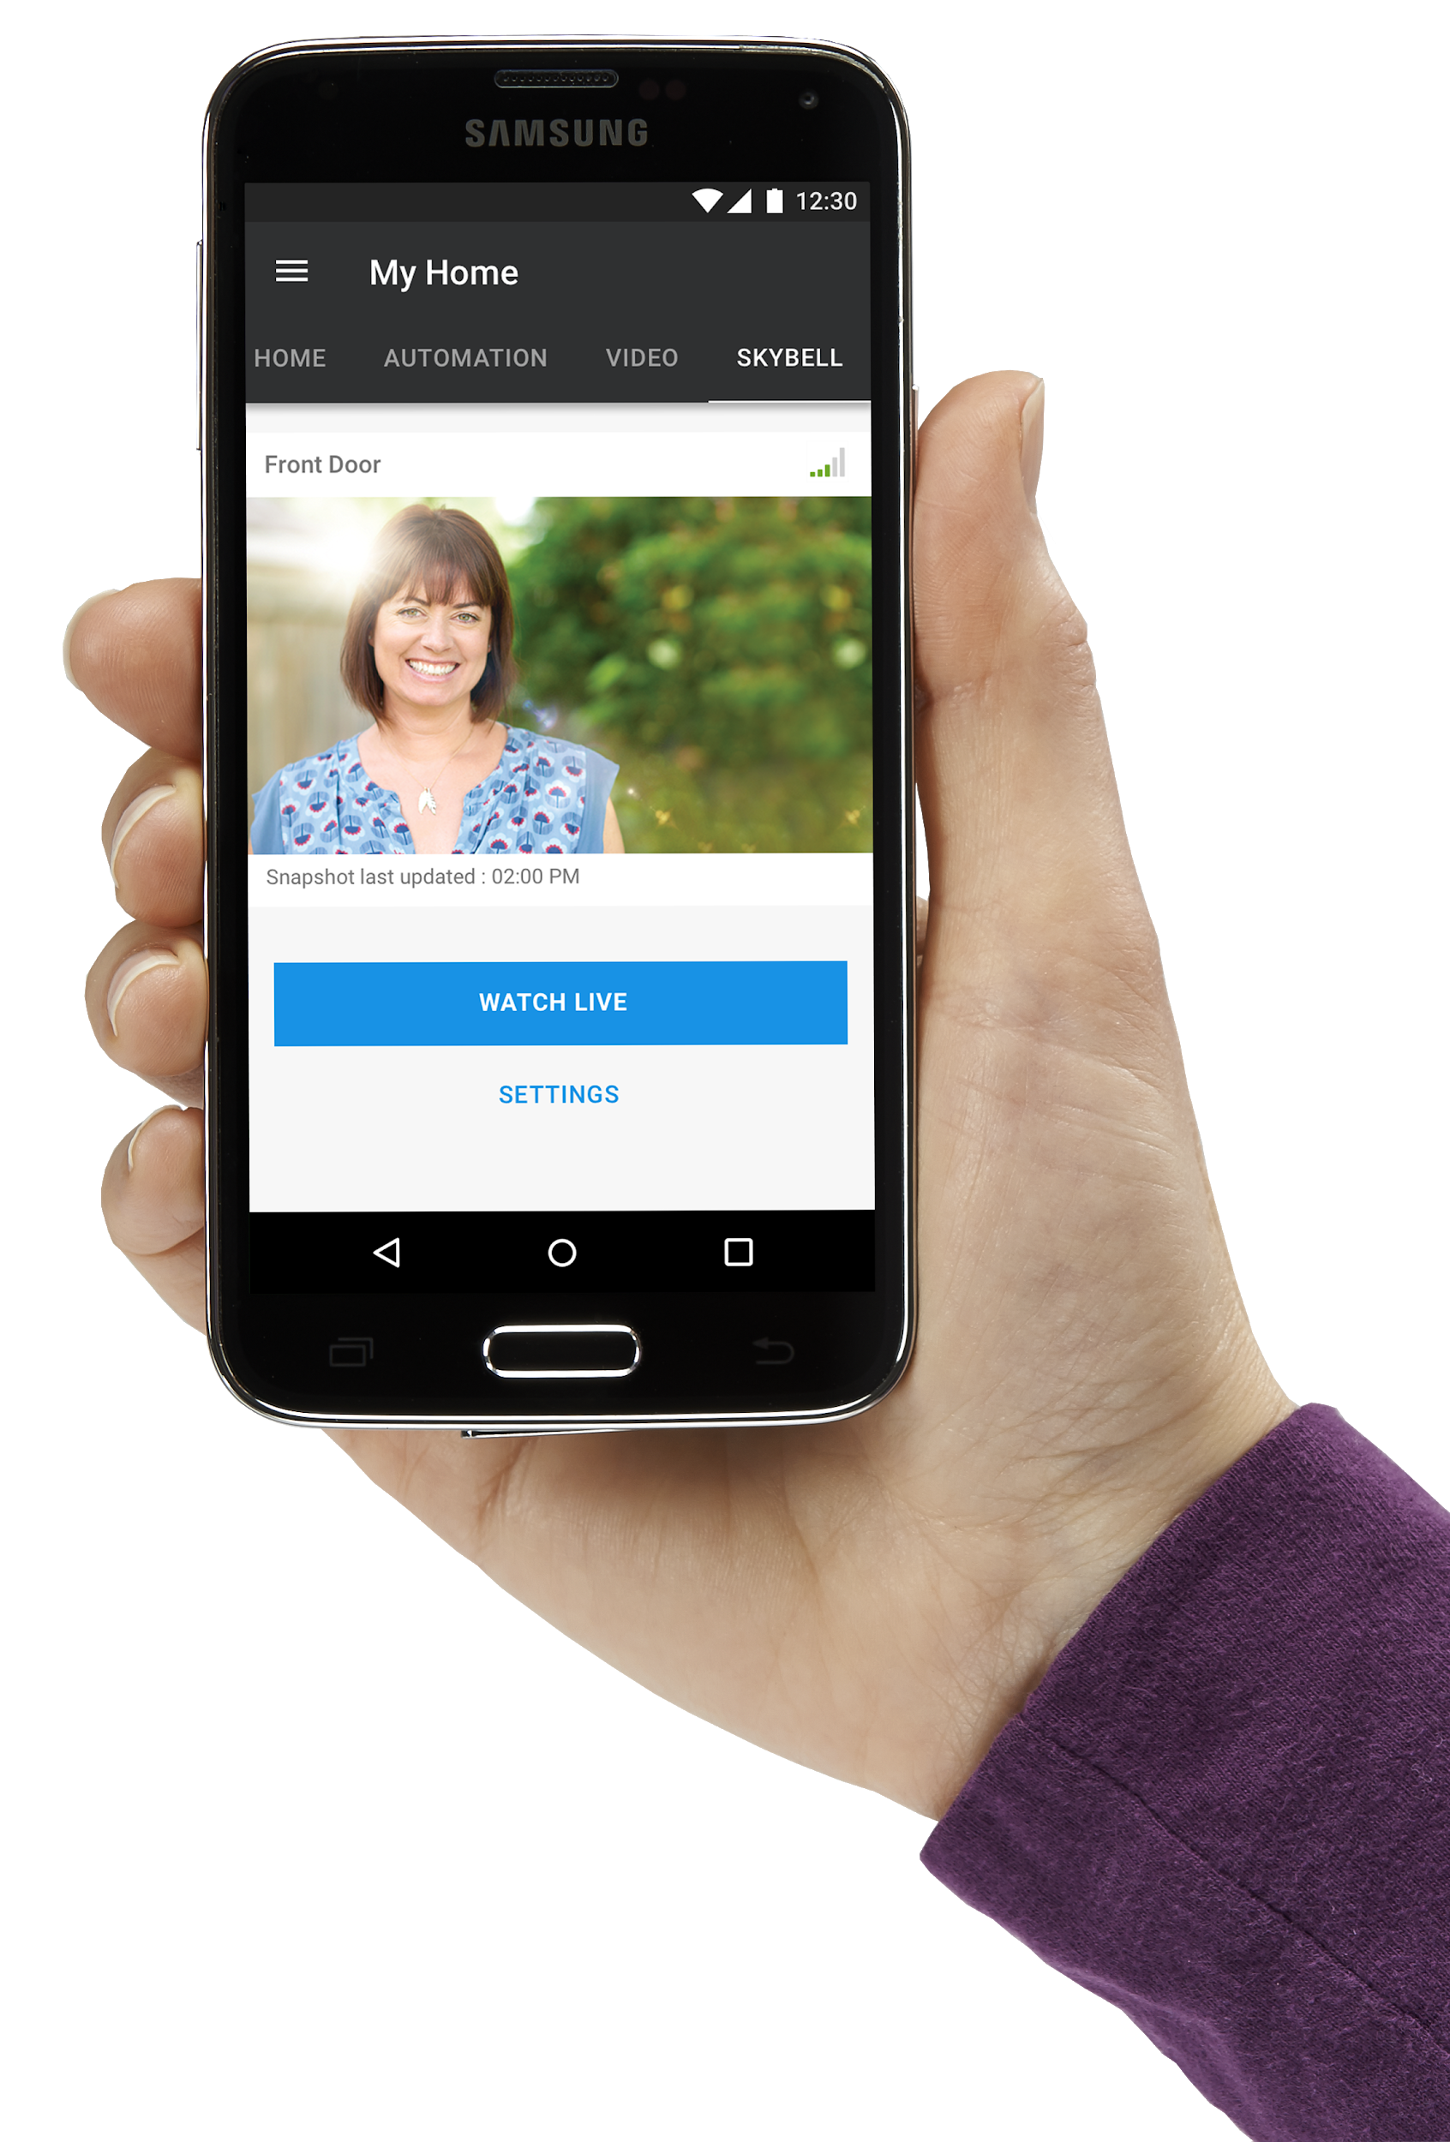
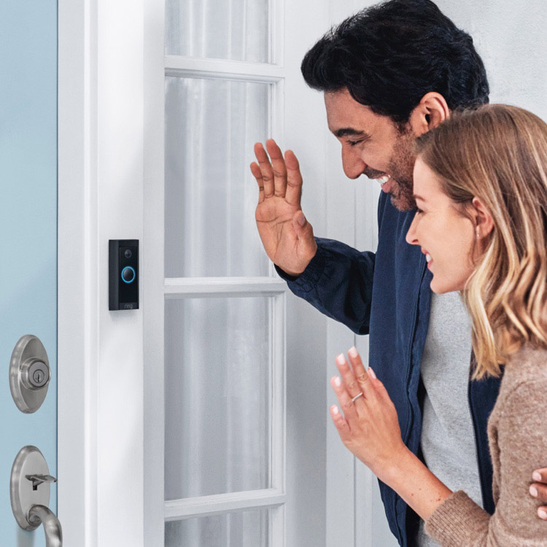
Introduction
Notes:
Ring

Slide 3
Hardware and Connections
RPI cam v2
Image quality upto 8 Megapixels.
Pimoroni Explorer Hat Pro
Button (simulates doorbell)
LED (simulates door status open/closed)

Slide 4
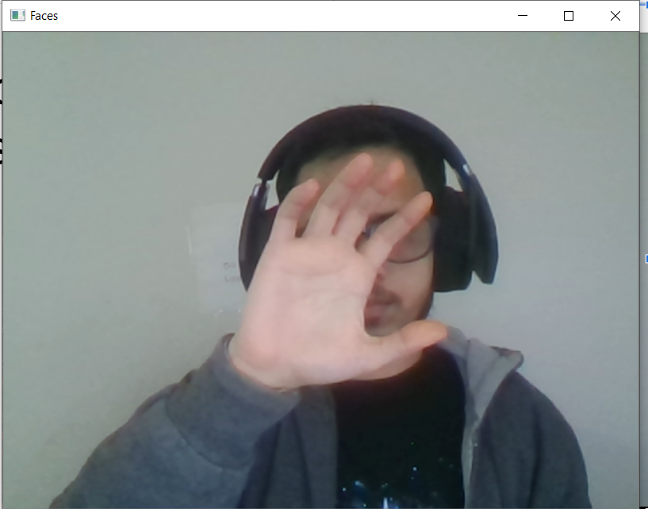
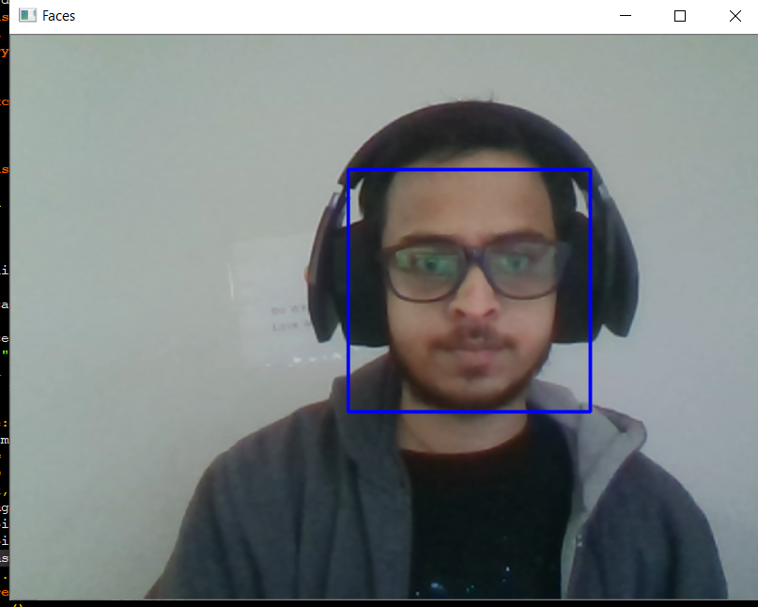
Machine Learning Model- Haar Cascade
Known as Viola-Jones algorithm.
Designed to extract haar like features, or simple features for rapid object detection
Training contains types of dataset
Positive set are images of required object
Negative set are images with everything else.
Extracted features are used to predict required objects from an image.

Slide 5
Working of face detection module
Working directory contains trained machine learning model an folder to save images.
RPi local host runs this script when doorbell is pressed.
Script starts to capture 60 continuous frames within 2 seconds.
Each frame is passed to the machine learning model to predict if face is present or not, and to get its location in image.

Slide 6
Working of face detection module-2
If the face is detected, this script confirms for a person to be present at the door.
If person detected, the script takes the latest picture and saves it in a folder
If scripts successfully executes, it returns with an exit code 0 or 2.
If there was any error during initialization of camera or importing the model or saving image, the script returns with error codes 1, 3 or 4.

Slide 7
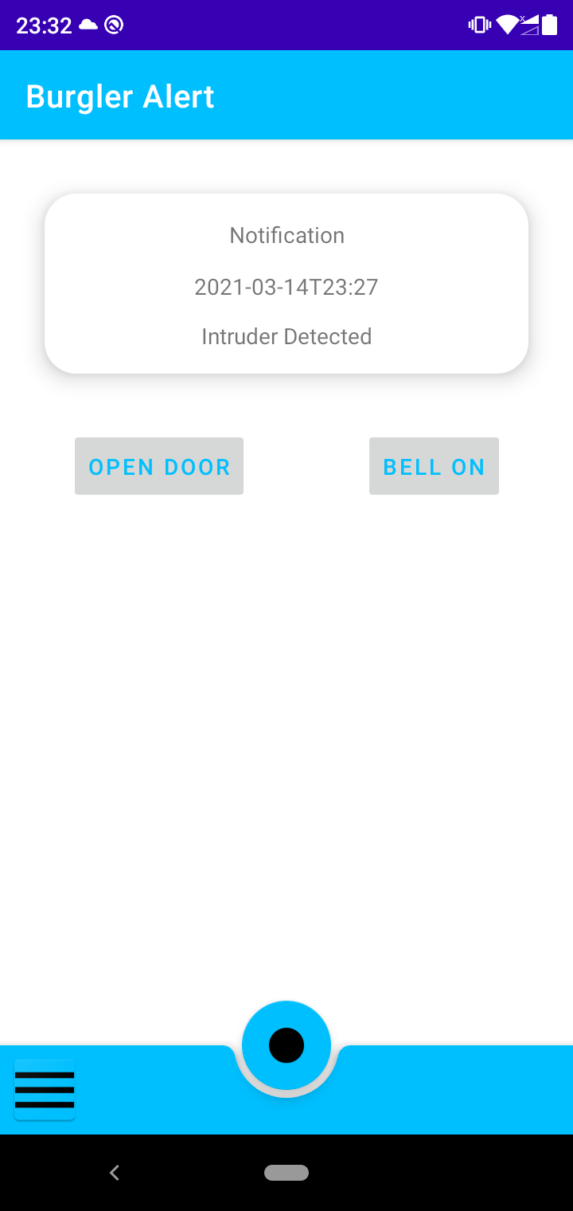
Android App
Functionality of the android app includes:
Receiving the notification when there is a intruder detected.
User can open the app once notified then has the ability to view the intruder face.
If the user wishes he can set the command to open the door.
Or he has the ability to ring the buzzer.
Notification is received through Firebase Cloud Messaging service.
Once user updates the values in the app the changes are made in the Firebase Realtime Database.

Slide 8
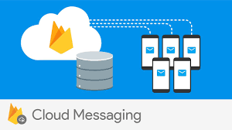
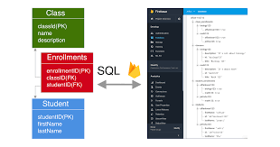
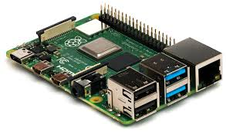
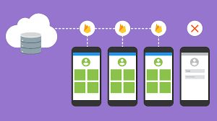
Interfacing with Firebase
Android app receives values from the raspberry pi using firebase web server.
Three components of Firebase web server are used:
Firebase Cloud Messaging - For app notification
Firebase Storage - For storing the image
Firebase Realtime Database - For storing the parameters between raspberry pi and android.
To connect these three services Cloud functions are deployed.

Slide 9
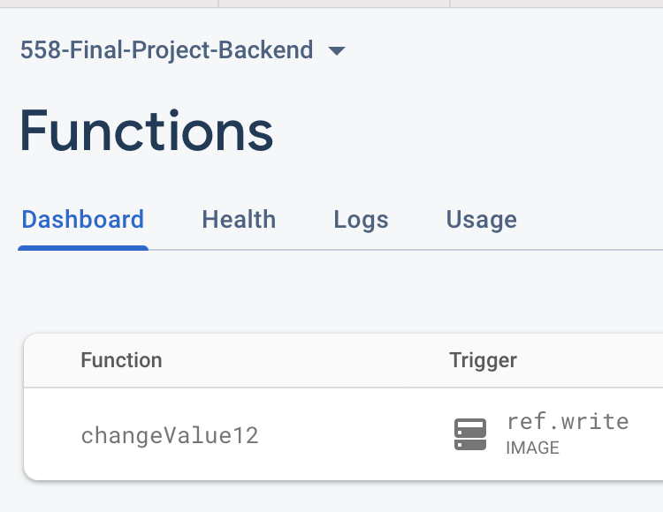
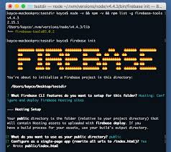
Cloud Functions
Backend program updates the Realtime database once face detected.
The database update uses the cloud functions deployed to trigger a notification using the Firebase Cloud Messaging service.
Cloud functions uses a javascript code deployed using the Firebase CLI.

Slide 10
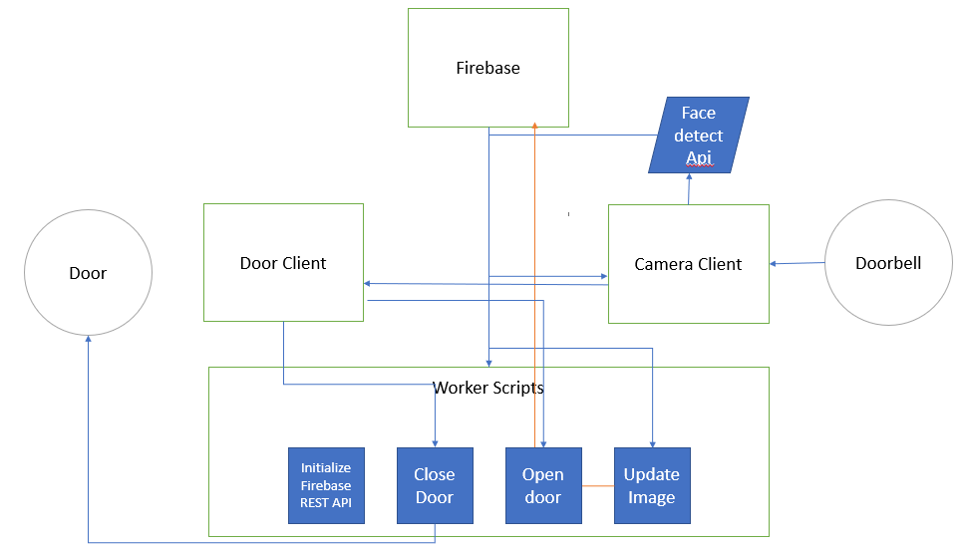
RPi Backend Flow

Slide 11
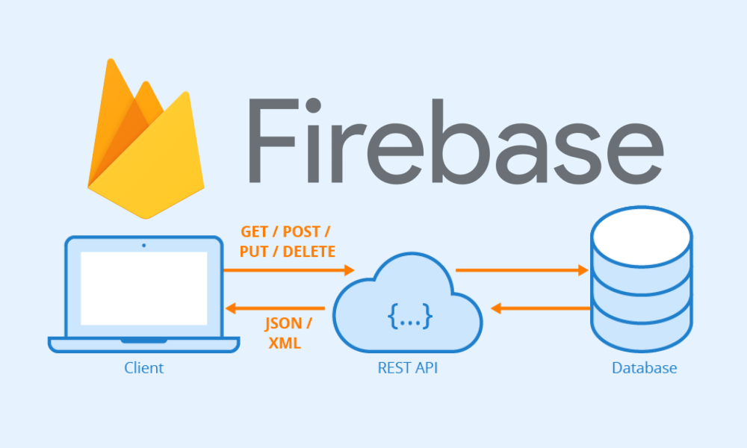
Firebase Admin SDK
Read and write Realtime Database data with full admin privileges.
Programmatically send Firebase Cloud Messaging messages using a simple, alternative approach to the Firebase Cloud Messaging server protocols.
Generate and verify Firebase auth tokens.
Access Google Cloud resources like Cloud Storage buckets and Cloud Firestore databases associated with your Firebase projects.
Create your own simplified admin console to do things like look up user data or change a user's email address for authentication.

Slide 12
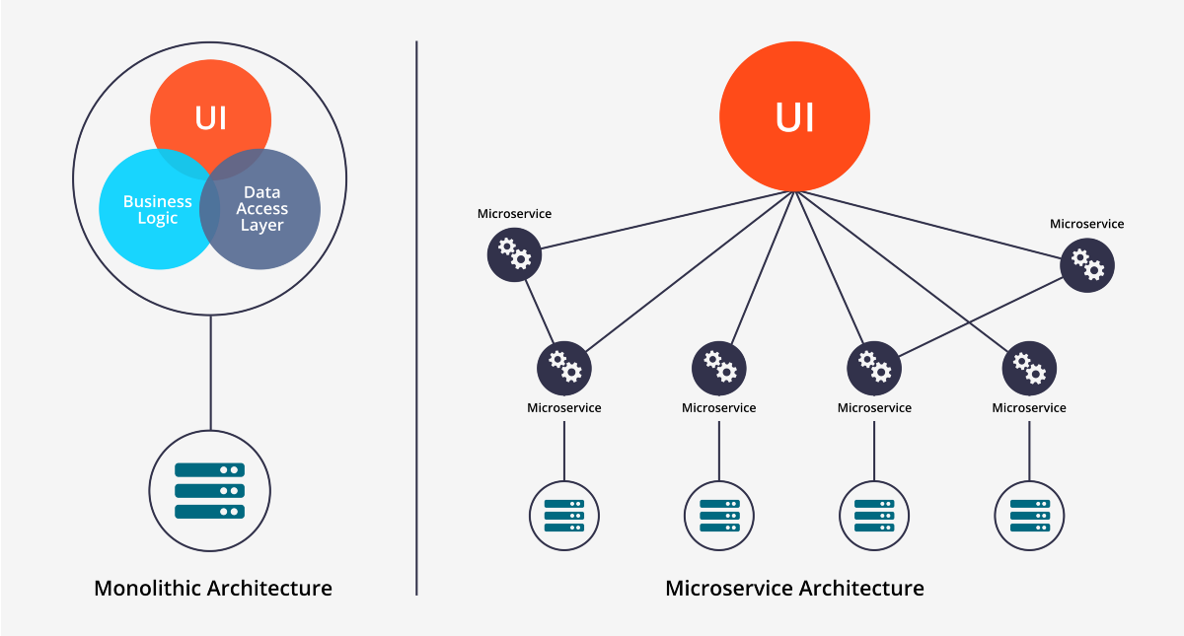
Microservice Architecture

Slide 13
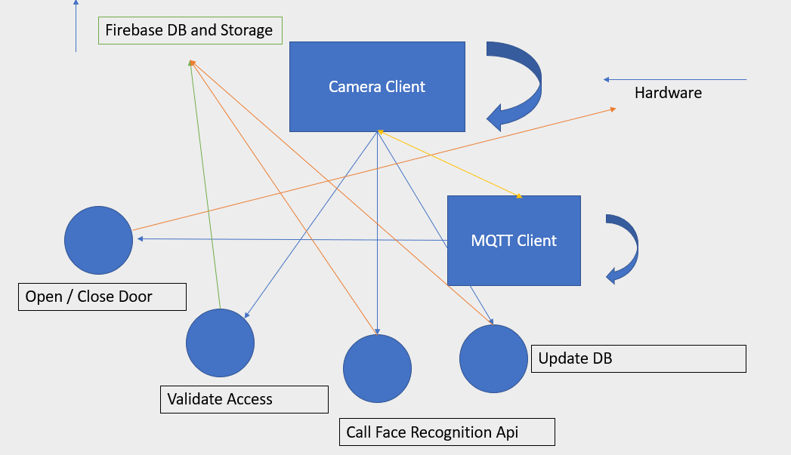

Slide 14
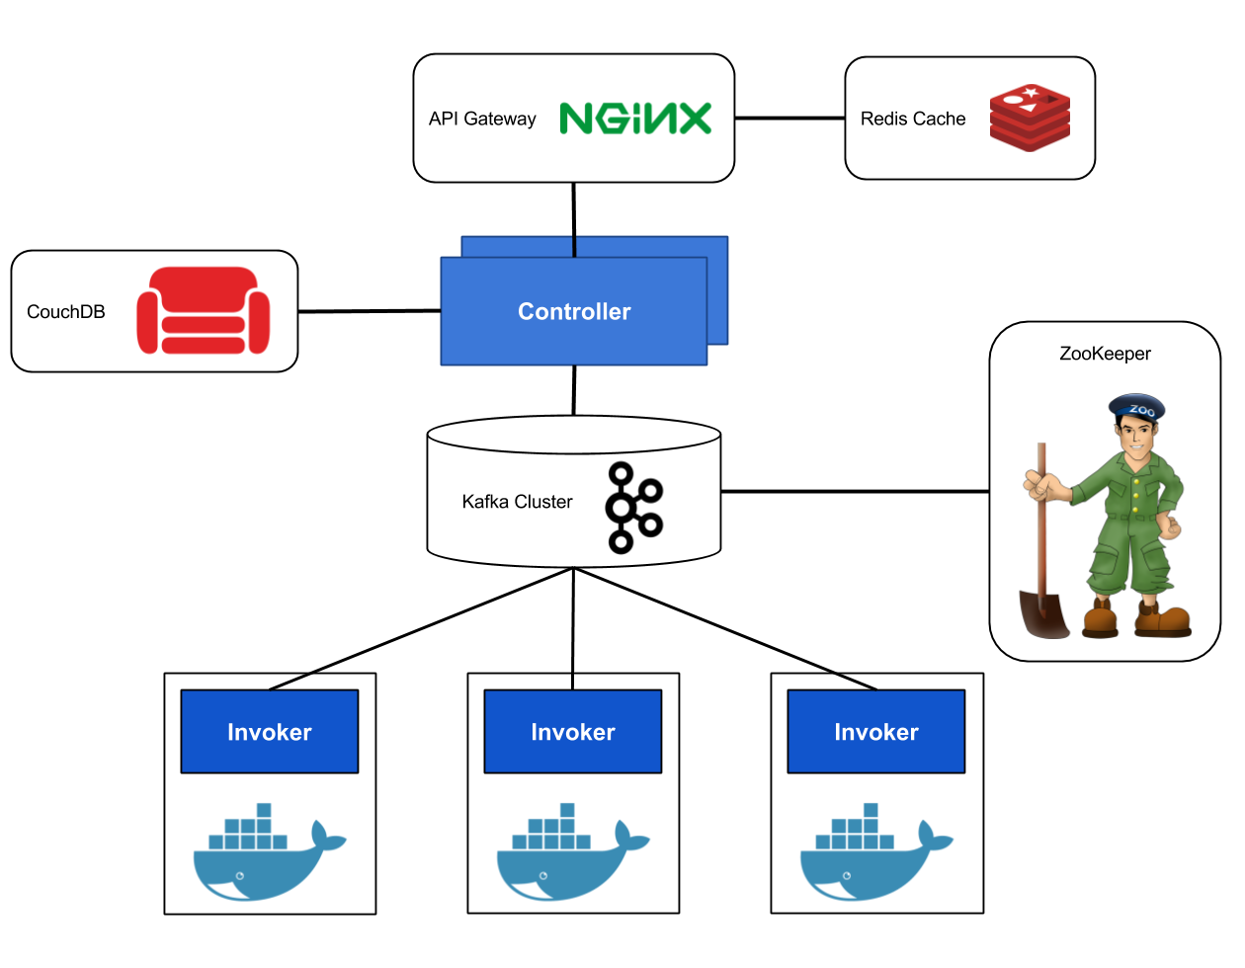
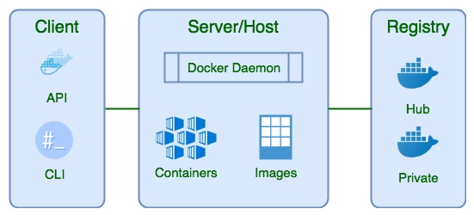
Further Work
Deploy using Docker
Deploy using multiple clients running in their own separate containers
Use Kafka to manage the cluster

